Slide 1
Examples of misusing scores in psychometric testing and applications to forensic psychology
Dr Julia Wolska

Slide 2
Usefulness of psychometric testing
Standardised methods
Screening for presence or absence of certain traits / shows continuum of certain traits
Notes:
Standardised methods: means it’s reliable and valid.

Slide 3
Examples of misusing scores
Intelligence tests
Sex differences
Race differences
Notes:
Note we talk specifically about sex differences here, not gender differences.

Slide 4
Sex differences intelligence testing
Paul Broca
“the relatively small size of the female brain depends in part upon her physical inferiority and in part upon her intellectual inferiority”
Gustave Le Bon
“In the most intelligent races, as among the Parisians, there are a large number of women whose brains are closer in size to those of gorillas than to the most developed male brains… They excel in fickleness, inconstancy, absence of thought and logic, and incapacity to reason. Without doubt there exist some distinguished women, very superior to the average man, but they are as exceptional as the birth of any monstrosity, as, for example, of a gorilla with two heads; consequently, we may neglect them entirely.”
Notes:
Brain size is correlated with intelligence, and men have bigger brains than women, even if accounted for height, but general consensus that men not more intelligent than women.

Slide 5
Race differences in intelligence testing
Racial IQ gap
IQ dependent on number of factors, including class (and ethnic minority people often disadvantaged)
Language and cultural problems

Slide 6
Eysenck: personality and cancer
Eysenck’s claim: certain personality variables (such as extraversion) at higher risk to cause cancer than tobacco (Eysenck, 1988; Kissen, & Eysenck, 1962)
However subsequent researchers found several methodological problems with the original studies (including suspected data manipulation) and could not replicate the studies (see: 2019 King’s College London enquiry, HE-Enquiry.pdf (retractionwatch.com))
Notes:
Eysenck’s research funded by tobacco industry.

Slide 7
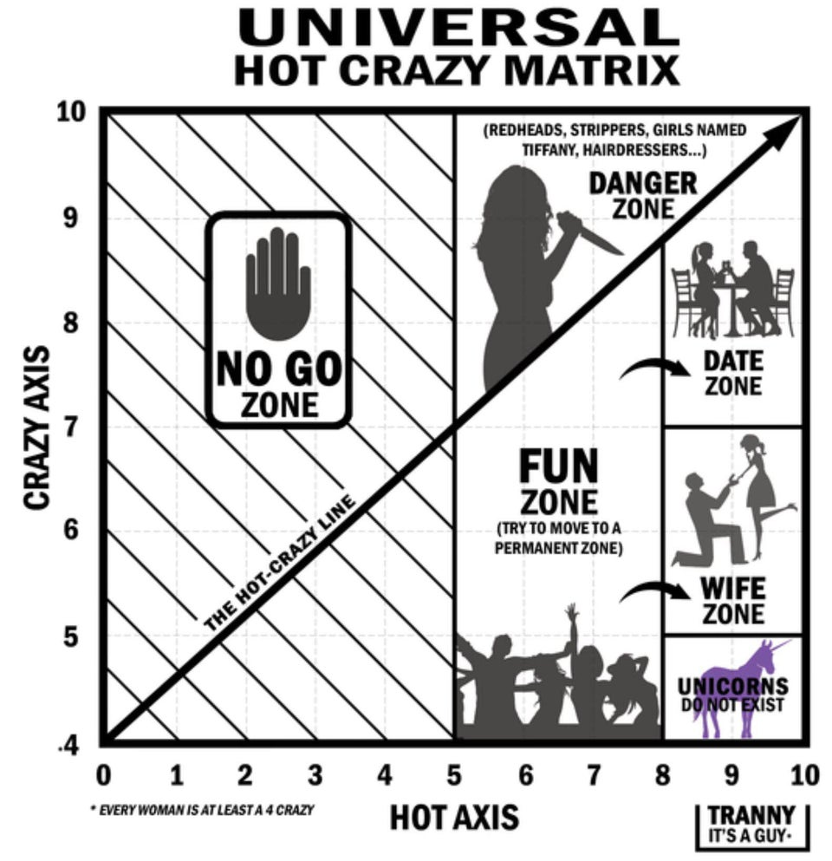
Barney Stinson: Hot Crazy Matrix (HCM)
Maps a person’s level of ‘hotness’ (physical attractiveness) against their level of ‘crazy’ (personality)
Notes:
Misogynistic Youtube video. Maps person’s (women’s) level of hotness (physical attractiveness) against their level of crazy (personality). Used in TV show ‘How I met your mother’.
The No Go Zone: women who are both unattractive and crazy.
The Danger Zone: women who are very attractive, but very crazy (“This is where your tyres get slashed and you end up in jail.”).
The Fun Zone: women who are moderately attractive and not too crazy.
The Date Zone: attractive women who are a little bit crazy.
The Wife Zone: women who are very attractive but only slightly crazy.
The Unicorn Zone*: mythical and elusive, near-extinct attractive group of women who are hardly crazy, but a 10 hot (“Capture it safely, keep it alive… we would like to study it.”).

Slide 8
HCM: Backed up by science?
Blanchard et al. (2021): Tested HCM
‘Craziness’ operationalised as borderline personality disorder (BPD) traits and secondary psychopathy traits
Found that men willing to engage with attractive women high in BPD
Women prefer wealth over attractiveness and prefer men low in psychopathy traits
Notes:
Men: cute-money matrix.

Slide 9
Blanchard et al. (2021): Scientific problems
Referred to HCM without specifying lack of scientific evidence
Only using sex, not testing gender
Not specifying sexual preferences of men and women
Using BPD traits to label ‘crazy’
Only using Caucasian faces
Women presented as ‘hot’ and ‘crazy’ and men presented as ‘cute’ and ‘rich’

Slide 10
Problems with psychometric testing
Self-report (Sanders, & Katz, 2013)
Lack of training
Online tests (Barak, & English, 2002; Naglieri et al., 2004)
Notes:
Self-report: Test will not be able to unmask traits test taker is not aware of. Especially intelligent person or person with knowledge might be aware of what test is trying to measure. Especially relevant in forensic testing, but also relevant when test taker might try to present themselves better or worse than they are.
Lack of training: people might use tests who have not been trained adequately, or might not use appropriate tests.
Online tests might not meet rigour scientific criteria, might leave person distressed if there is no psychologist to talk to about scores. Of course problematic for people who might not be competent with IT.

Slide 11
Statistical problems with psychometric testing
Sample size
Norm group
Reliability (consistency of measure)
Validity (is test measuring what it claims to measure)
Notes:
Already mentioned in workshops and lectures, just as a reminder.

Slide 12
Applications to forensic psychology
Be aware of cultural and language barriers (Weiss, & Rosenfeld, 2012)
Lack of training
PCL-R: Not confuse psychopathy with antisocial personality disorder (Hare, 1998)
Eyewitness testimony -> false memories (Loftus, & Palmer, 1974; Loftus, & Pickrell, 1995)
Guantánamo: “enhanced interrogation” (previously recognised as torture) (e.g., Iacopino, & Xenakis, 2011)
Notes:
Eyewitness testimony: danger of falsely convicting someone or missing a criminal.
False memories: danger of inflicting false memories. Loftus and Palmer showed that suggestive wording has big effects..
Guantanamo: established after 9/11 for Muslim extremists and suspected terrorists. Medical personnel misused psychological tests, e.g. psychological symptoms commonly attributed to personality disorders, PTSD seemed to be present based on symptoms but not diagnosed.

Slide 13
Applications to forensic psychology
Be aware of dubious test on the internet (no scientific background)
Be aware of language use (using words such as psychopath, narcissist,…)
Notes:
On the internet, there is for example the psychopathtest.com, which only has dichotomous (yes and no) answers and seems to lack scientific background.
Be aware of language use: they are such as psychopath! They are such a stalker! They are such a narcissist!

Slide 14
References
Barak, A., & English, N. (2002). Prospects and limitations of psychological testing on the Internet. Journal of Technology in Human Services, 19(2-3), 65-89.
Blanchard, A. E., Dunn, T. J., & Sumich, A. (2021). Borderline personality traits in attractive women and wealthy low attractive men are relatively favoured by the opposite sex. Personality and Individual Differences, 169, 109964.
Eysenck, H.J. (1988). Personality, stress and cancer: Prediction and prophylaxis. Psychology and Psychotherapy, 61(1), 57-75.
Hare, R. D. (1998). The Hare PCL‐R: Some issues concerning its use and misuse. Legal and criminological psychology, 3(1), 99-119.
Iacopino, V., & Xenakis, S. N. (2011). Neglect of medical evidence of torture in Guantanamo Bay: a case series. PLoS Med, 8(4), e1001027.
Kissen, D.M., & Eysenck, H.J. (1962). Personality in male lung cancer patients. J Psychosom Res, 62, 123-127.
Loftus, E. F., & Palmer, J. C. (1974). Reconstruction of auto-mobile destruction: An example of the interaction between language and memory. Journal of Verbal Learning and Verbal behavior, 13, 585-589.
Loftus, E. F., & Pickrell, J. E. (1995). The formation of false memories.
Naglieri, J. A., Drasgow, F., Schmit, M., Handler, L., Prifitera, A., Margolis, A., & Velasquez, R. (2004). Psychological testing on the Internet: new problems, old issues. American Psychologist, 59(3), 150.
Sanders, J. D., & Katz, S. H. E. B. A. (2013). The overuse and misuse of psychological testing: Why less is more. American Journal of Family Law, 26(4), 221-226.
Weiss, R. A., & Rosenfeld, B. (2012). Navigating cross-cultural issues in forensic assessment: Recommendations for practice. Professional Psychology: Research and Practice, 43(3), 234–240.

